Slide 1
Group 4
Akshita Chawdhary
Bhumika Khandelwal
Manika Nangia
Neha Palsokar
Prateek Tripathi

Slide 2
Agenda
.
01
Overall Assessment of Resellers
02
Bonus Recommendations for 2013 and 2014
03
Sale Trends by Day of the Week
04
Performance of Resellers when colocated with other types of sales

Slide 3
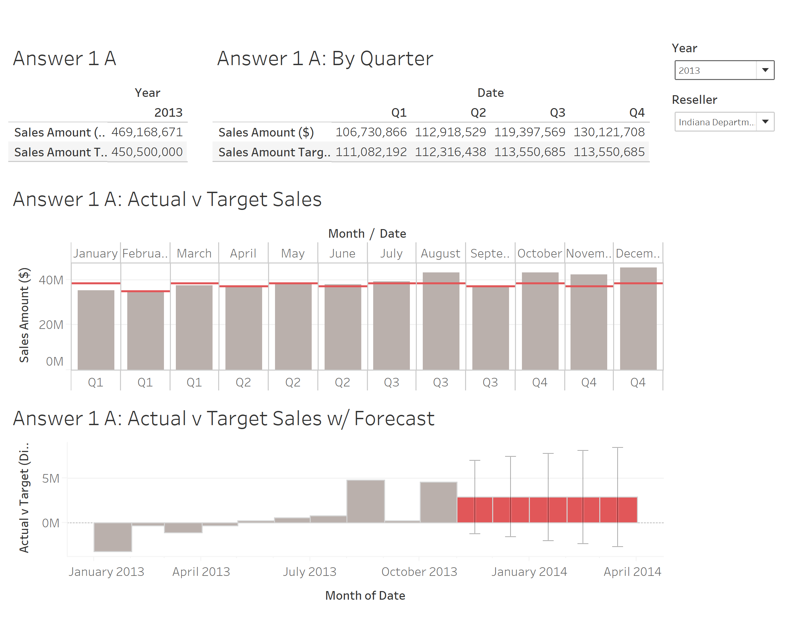
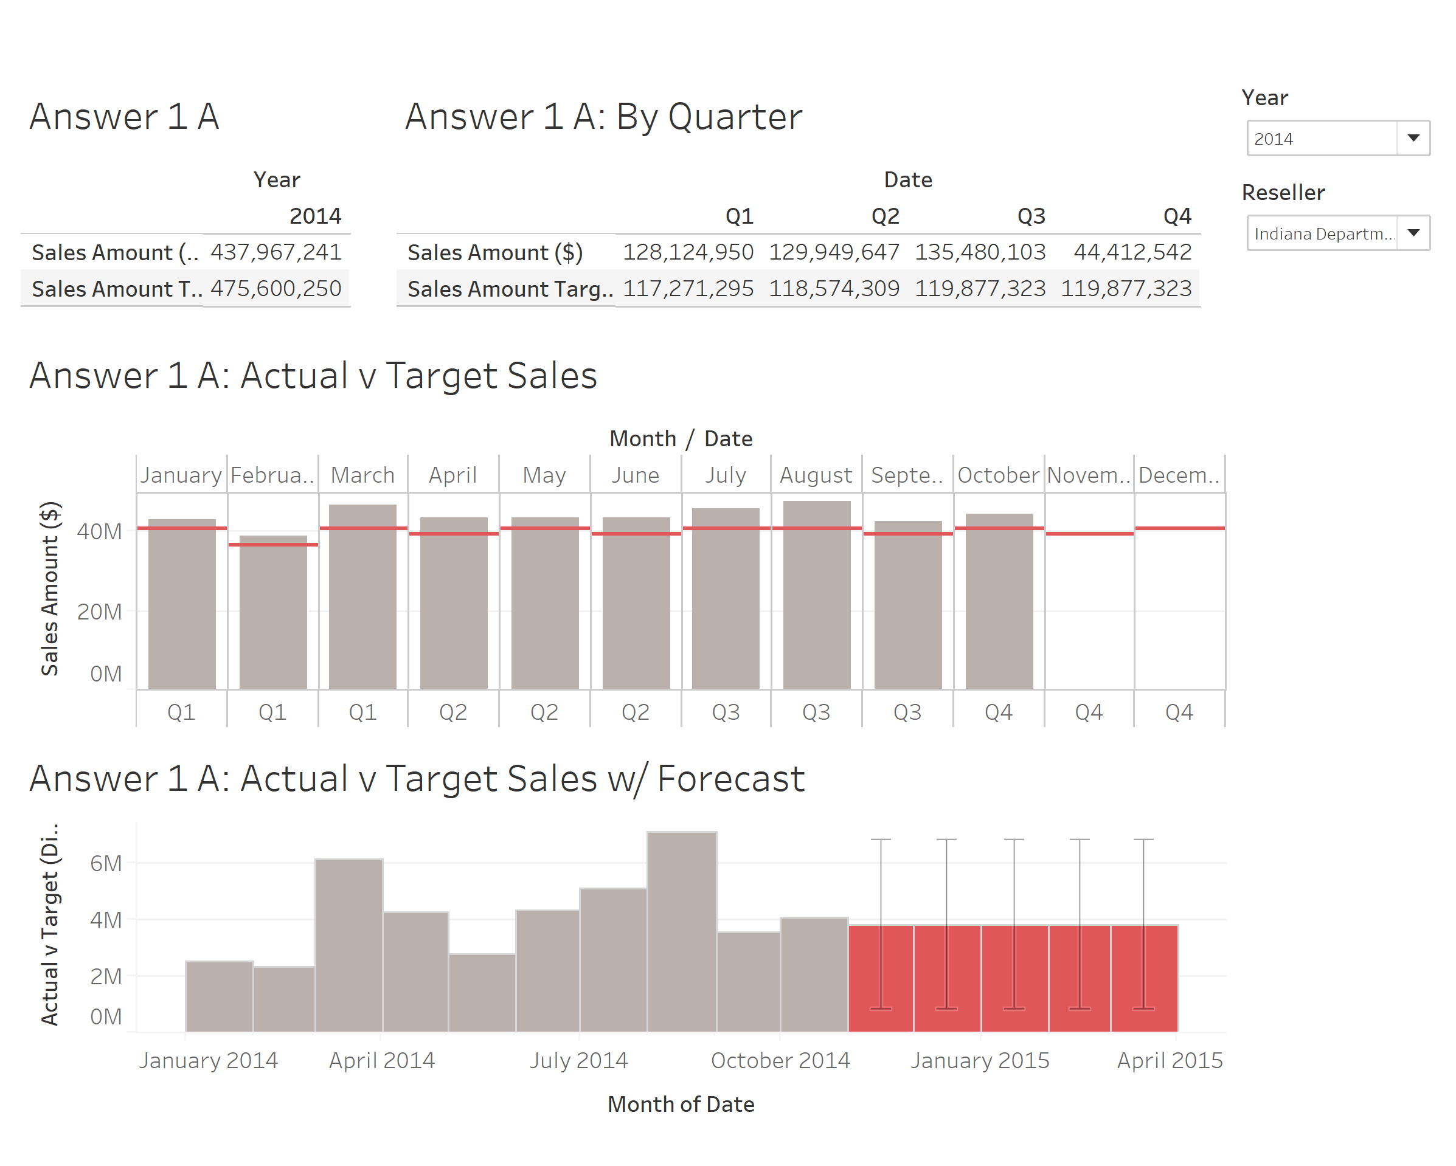
1 A: How has each of the resellers performed against target in 2013 and so far in 2014?
Do you expect them to meet the target in 2014 by the end of the year?
Reseller: Department Stores

Slide 4
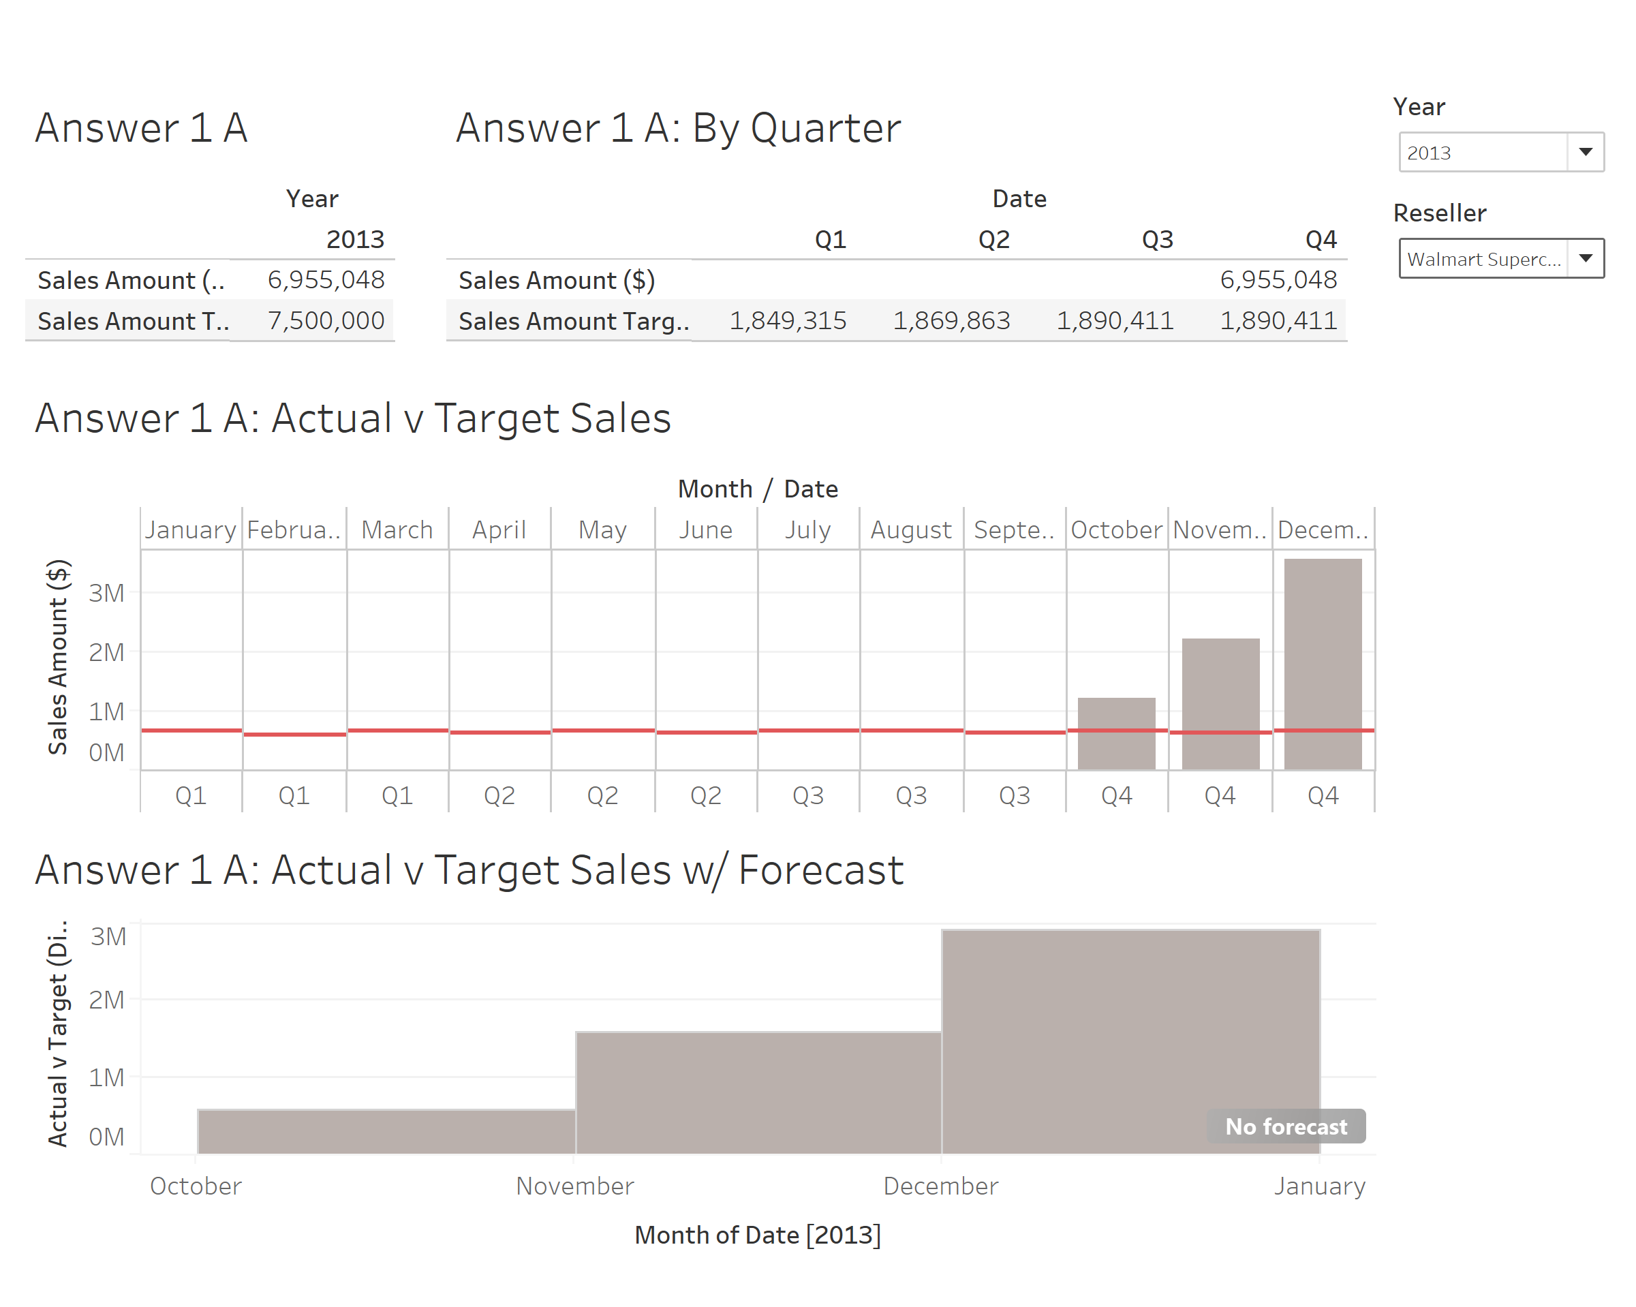
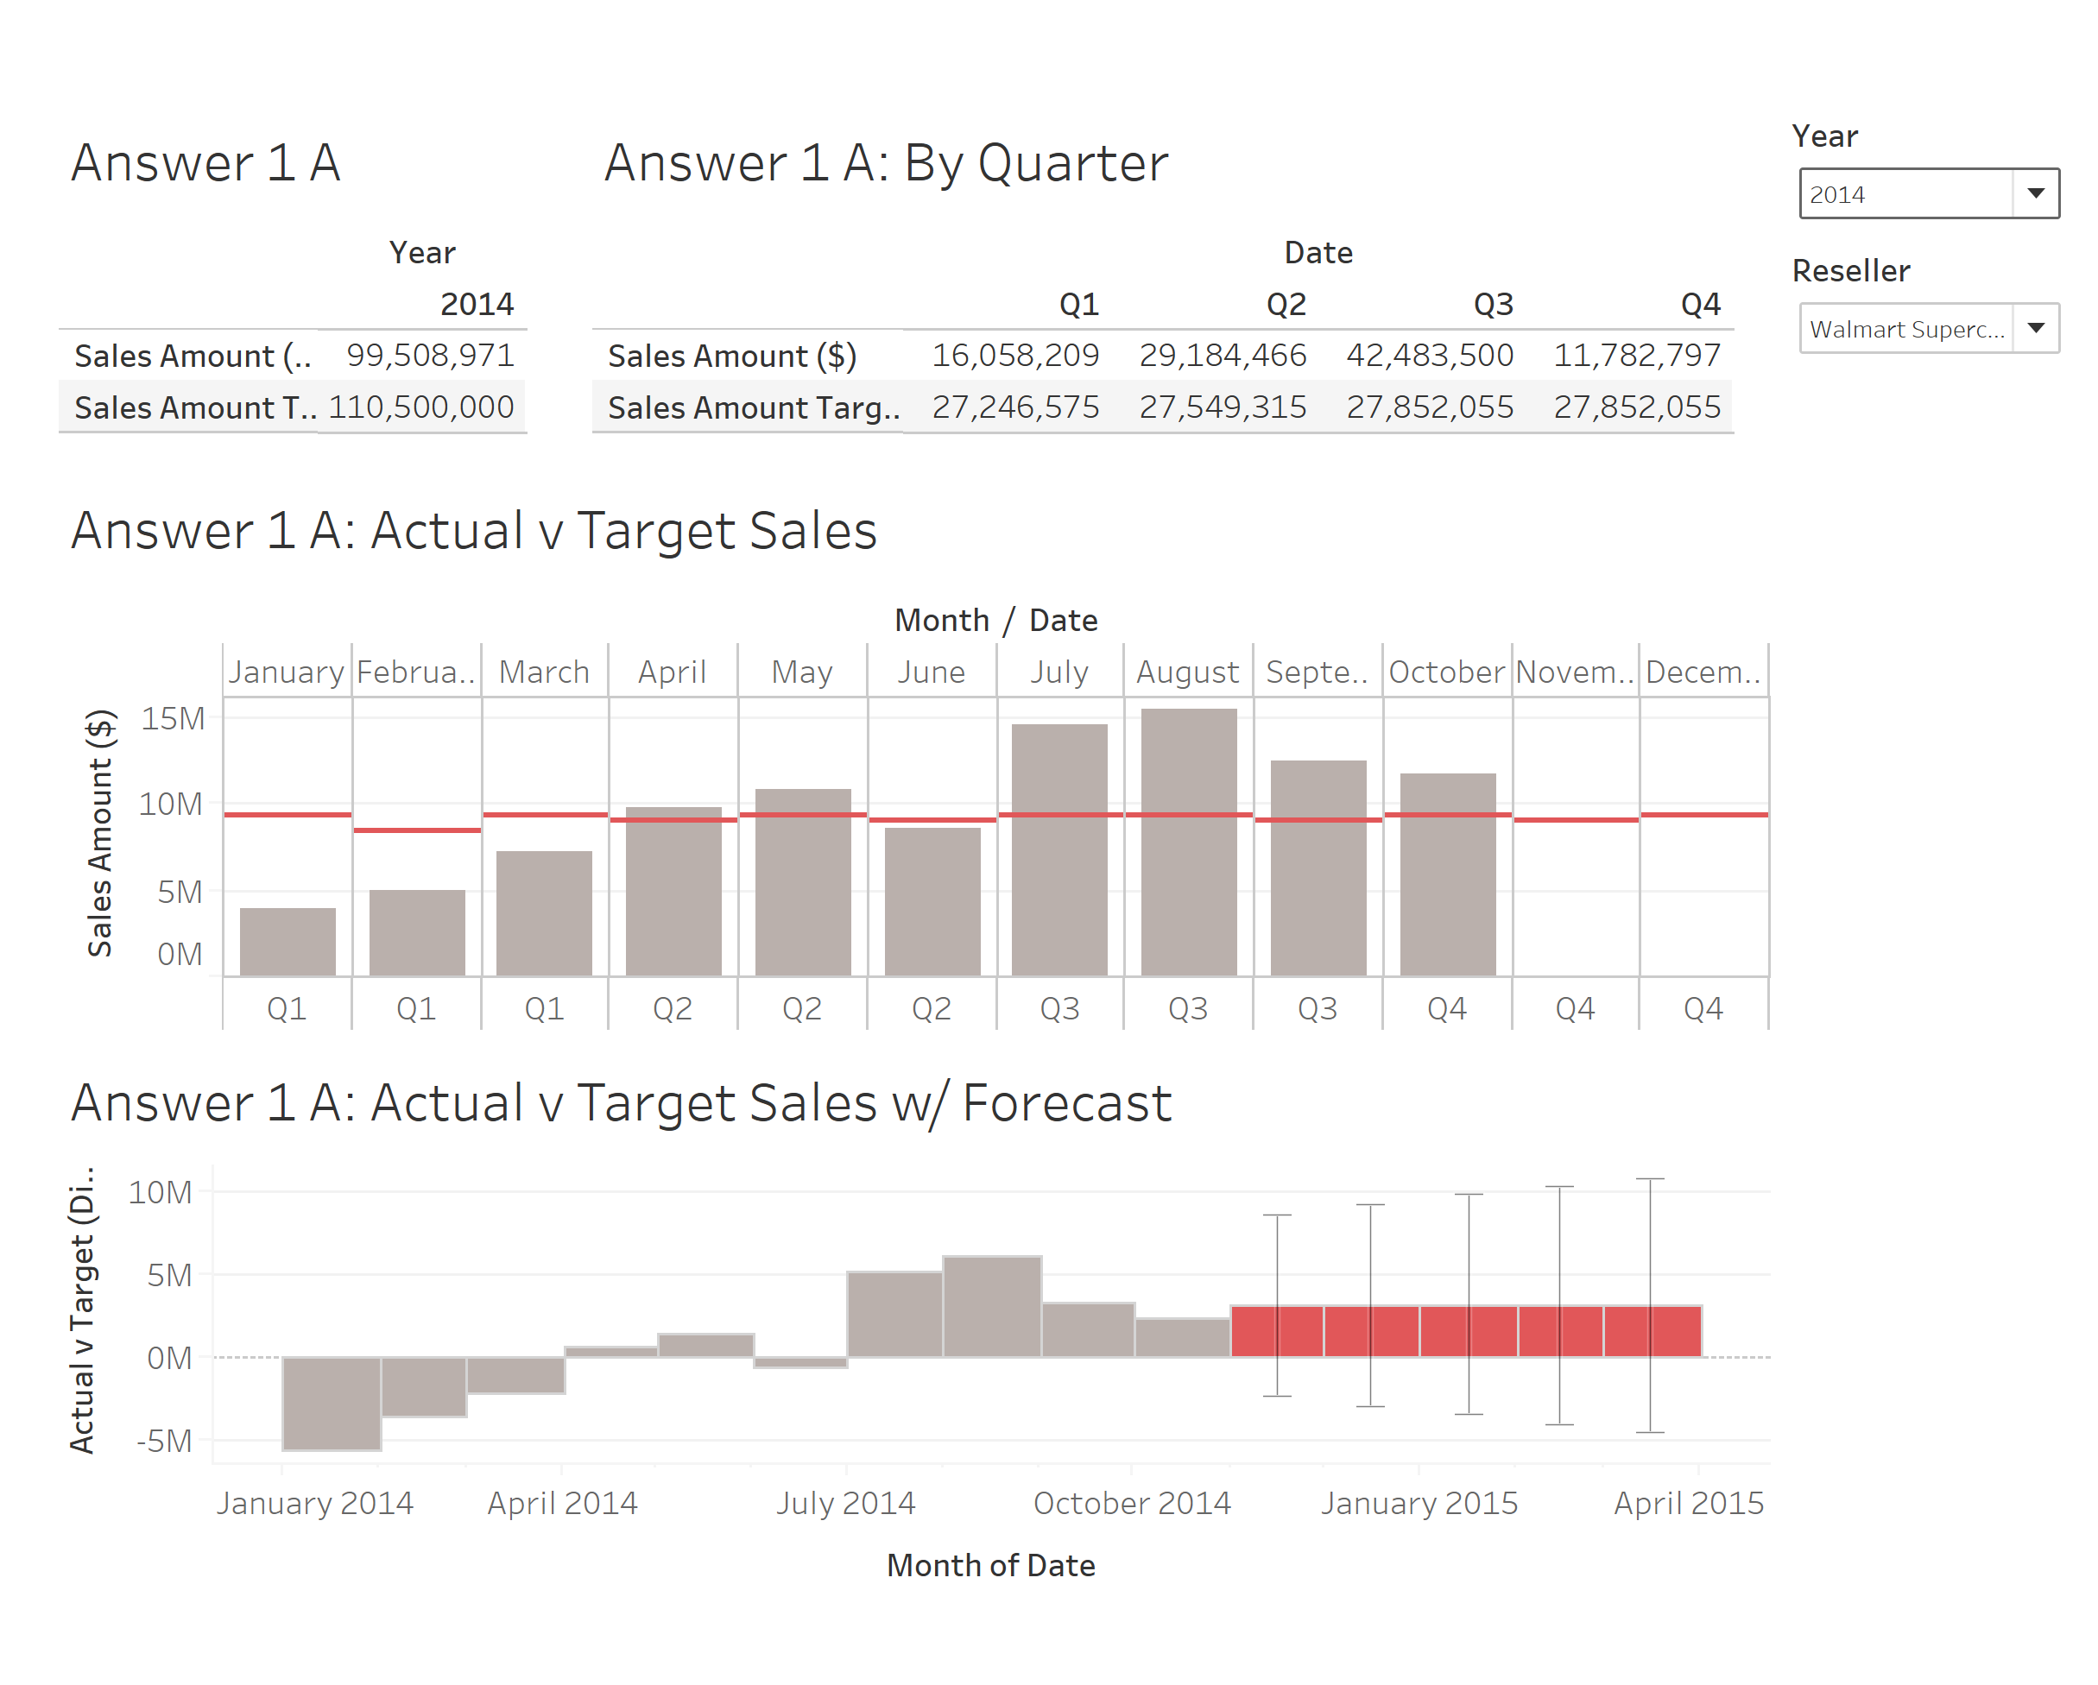
1 A: How has each of the resellers performed against target in 2013 and so far in 2014?
Do you expect them to meet the target in 2014 by the end of the year?
Reseller: Department Stores

Slide 5
1 A: How has each of the resellers performed against target in 2013 and so far in 2014?
Do you expect them to meet the target in 2014 by the end of the year?
Indiana Department Store met their targets in the year 2013, with observed strong performance in Q4
It can be observed that they have met their targets in every month (and every quarter) of the year 2014 so far, and their performance forecast suggests that they will meet their yearly targets with acceptable confidence
Walmart Supercenter didn’t meet their targets in the year 2013, with observed sales posted only for the 4th quarter
It can be observed that they are possibly growing with each month (and each quarter) with mostly increasing Sales Amount; we can expect them to meet their yearly targets as the remaining $ 10,991,029 (Target - Actual) can be met if we rely on the forecasted sales
Reseller: Department Stores

Slide 6
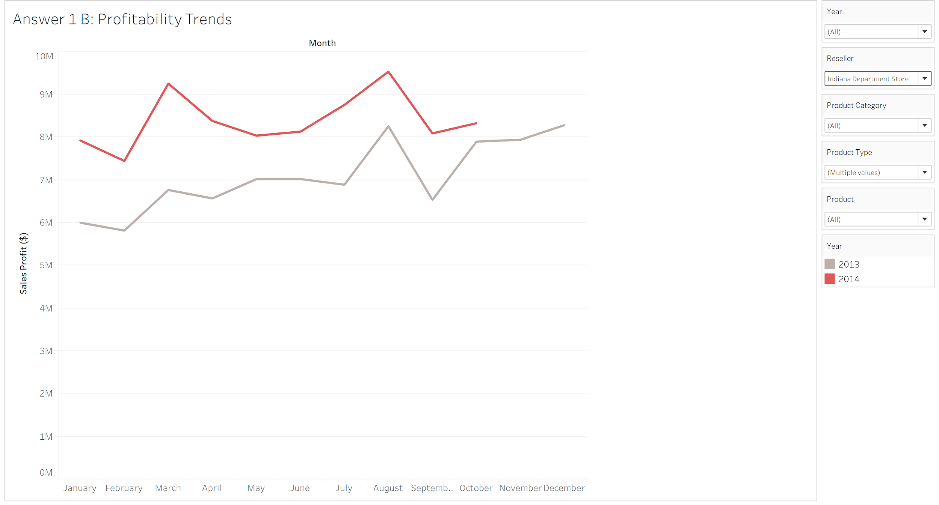
1 B: Compare the profitability trend of the two resellers. Should any resellers be used
more or less in the future?

Slide 7
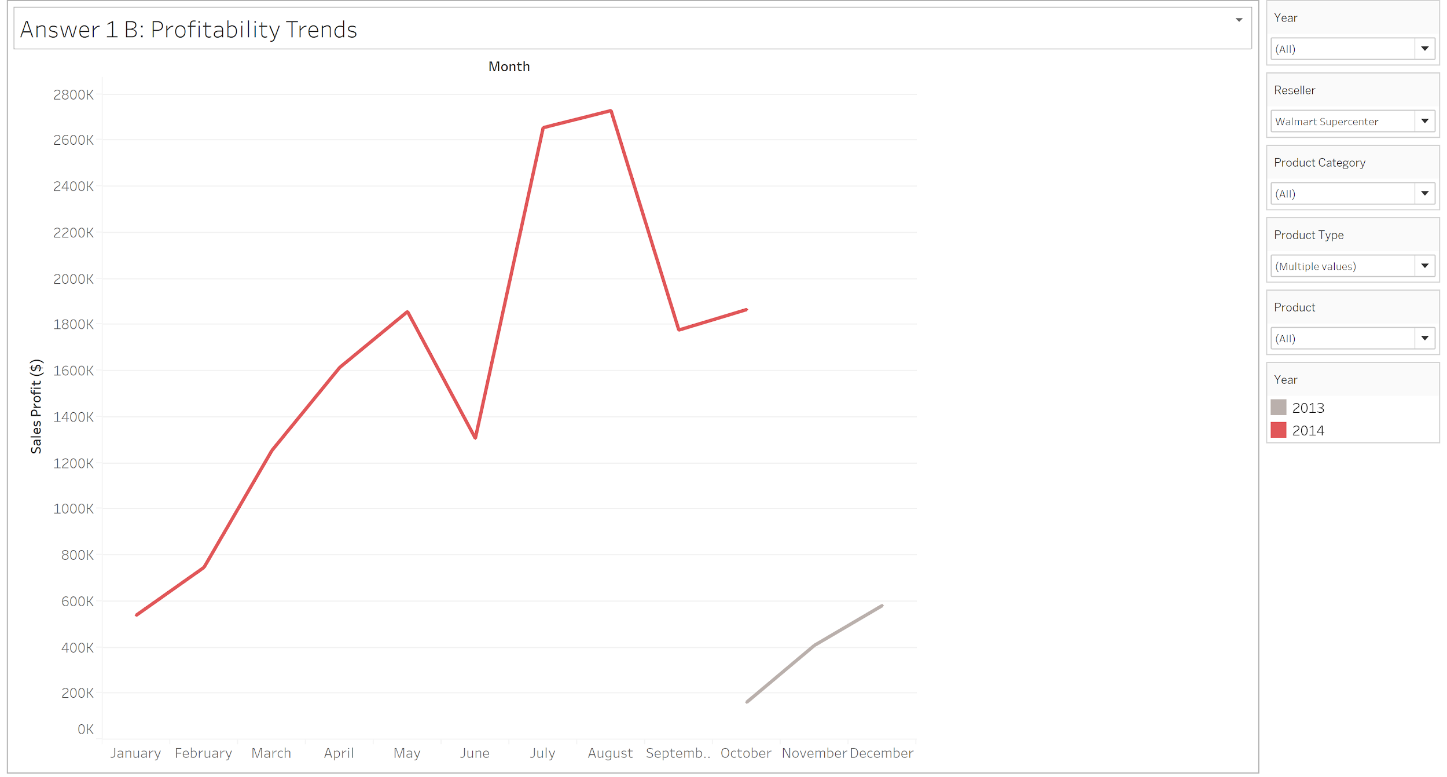
1 B: Compare the profitability trend of the two resellers. Should any resellers be used
more or less in the future?

Slide 8
1 B: Compare the profitability trend of the two resellers. Should any resellers be used
more or less in the future?
We observe that Indiana Department Store has an upward trend in their profitability if we compare the years 2013 and 2014
The same is true for Walmart Supercenter if we compare the years 2013 and 2014, although we can only directly compare the sales for the month of October (as we have data only starting from October, 2013) with more than 10 folds rise in their profit
Rate of rise in profits is more for Walmart Supercenter as compared to Indiana Department Store
Walmart Supercenter could be used more as the rate of rise in their profits is very high

Slide 9
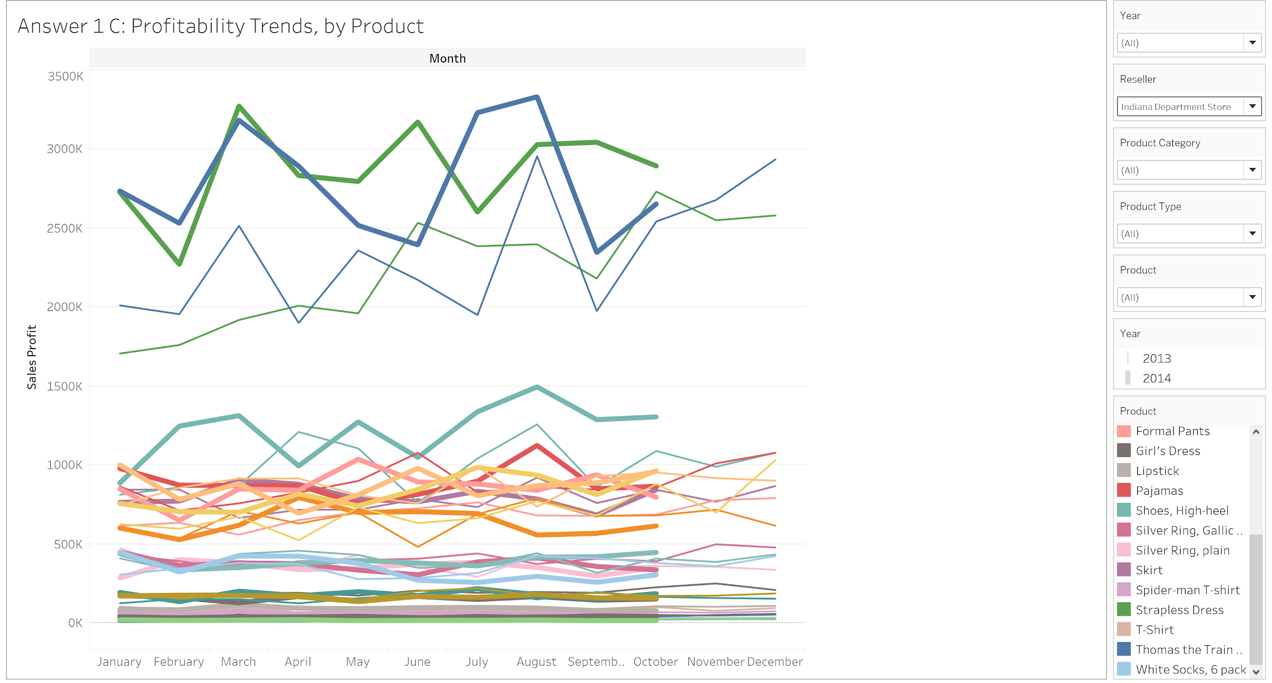
1 C: Recommend a marketing strategy for the individual Resellers, which products/product type/ product category should be featured? What should be done in the next year to maximize reseller profits?
Notes:
Display of all the products in the year 2013 and 2014 for Indiana Department Store

Slide 10
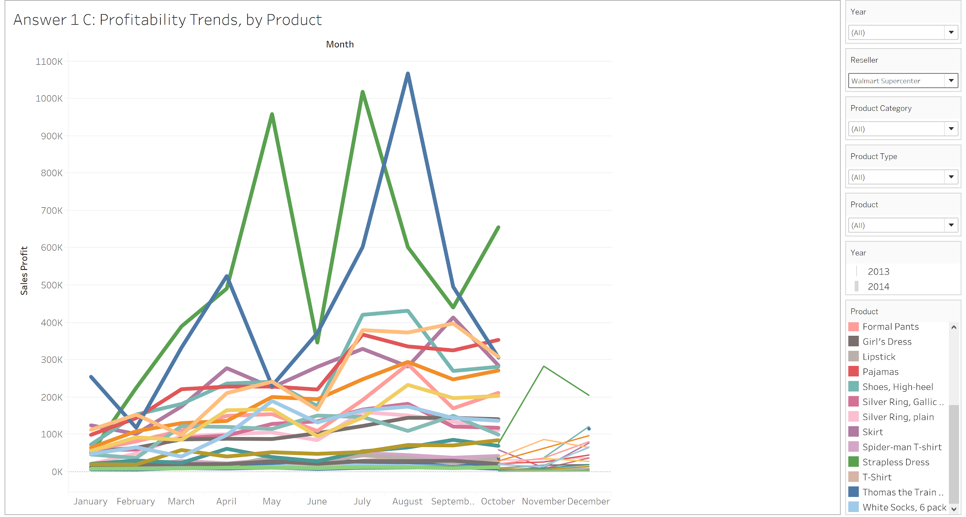
1 C: Recommend a marketing strategy for the individual Resellers, which products/product type/ product category should be featured? What should be done in the next year to maximize reseller profits?
Notes:
Here we can see that for Walmart Reseller, the profit by Strapless dress and Strapless dress is the most in 2013

Slide 11
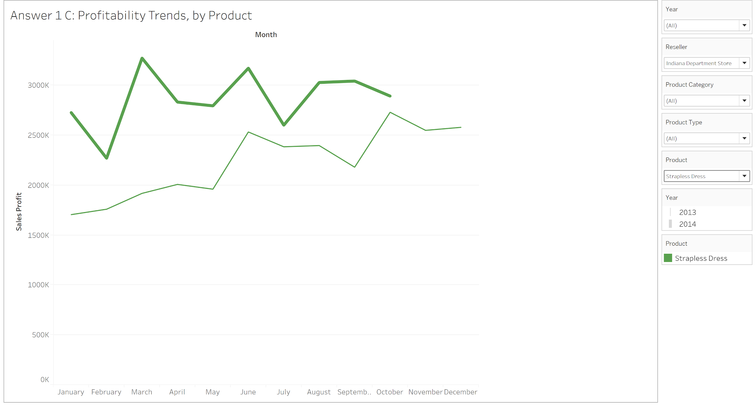
1 C: Recommend a marketing strategy for the individual Resellers, which products/product type/ product category should be featured? What should be done in the next year to maximize reseller profits?

Slide 12
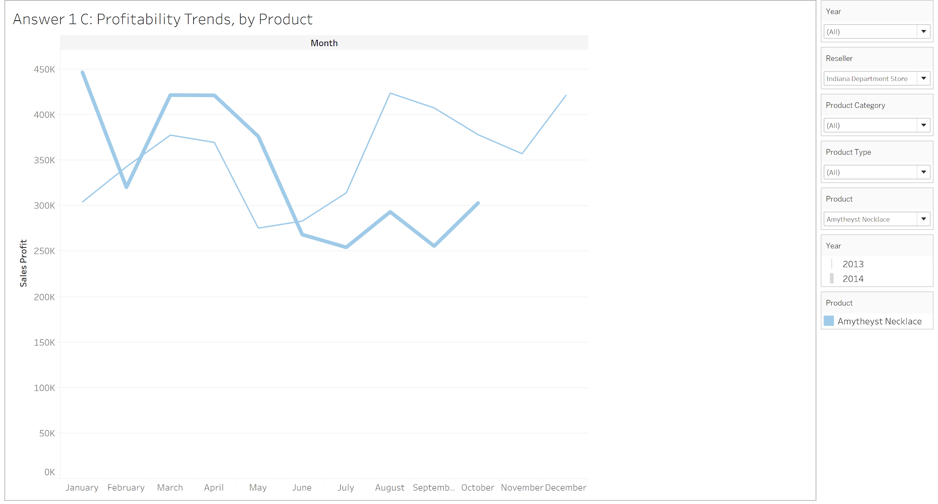
1 C: Recommend a marketing strategy for the individual Resellers, which products/product type/ product category should be featured? What should be done in the next year to maximize reseller profits?

Slide 13
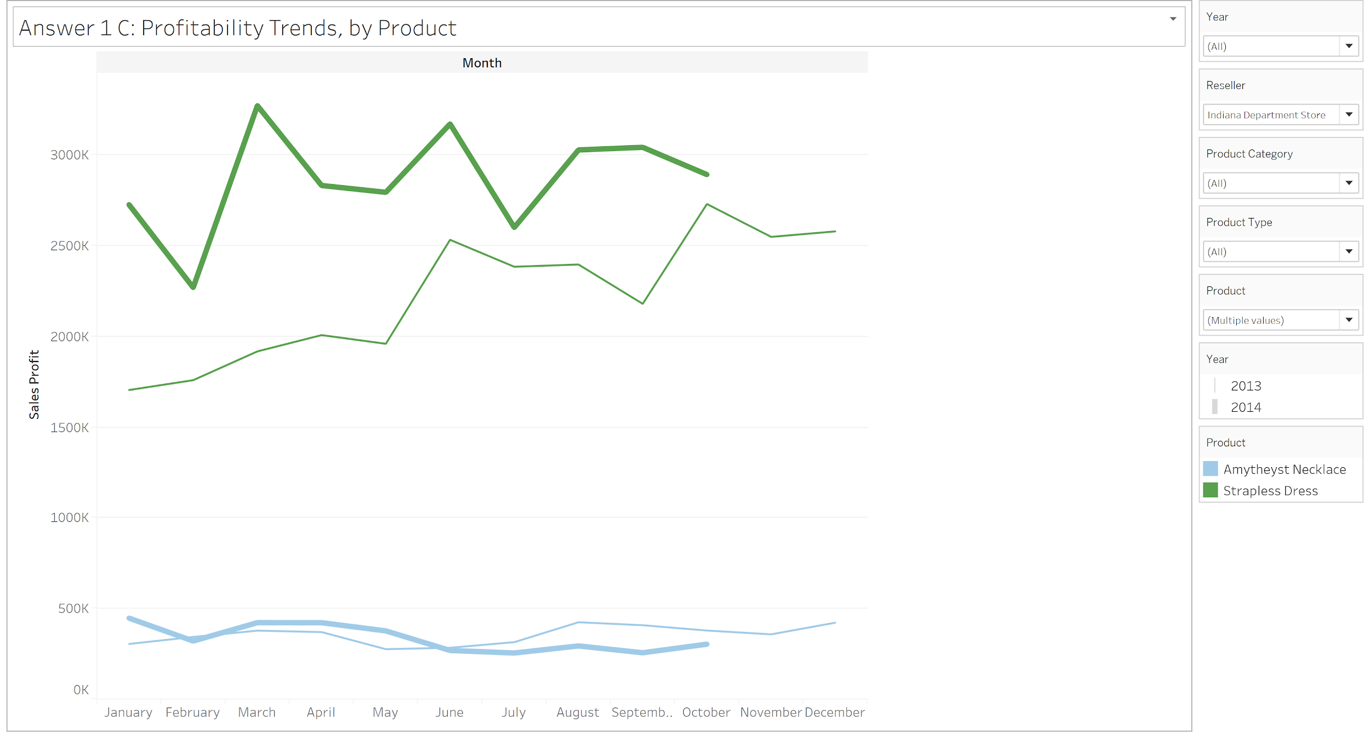
1 C: Recommend a marketing strategy for the individual Resellers, which products/product type/ product category should be featured? What should be done in the next year to maximize reseller profits?

Slide 14
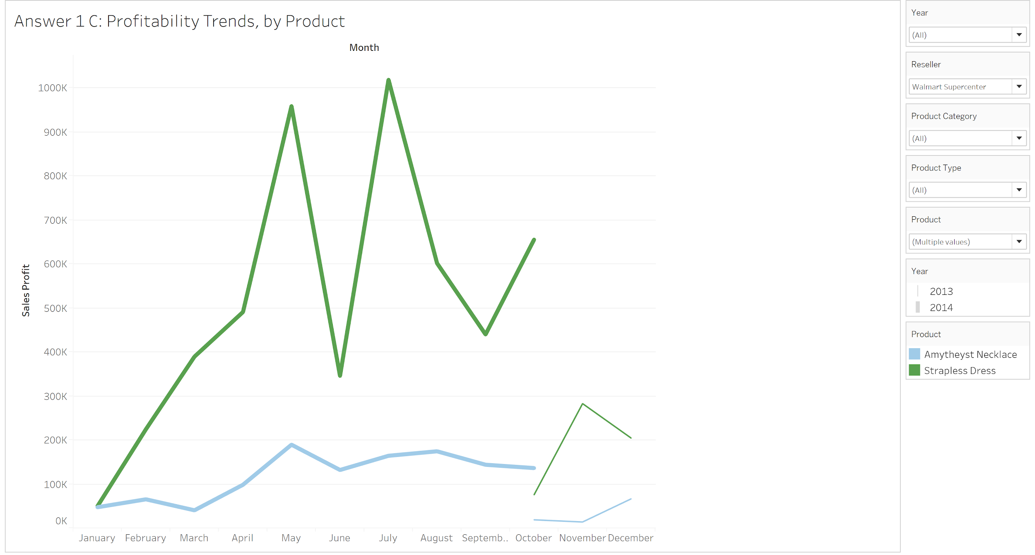
1 C: Recommend a marketing strategy for the individual Resellers, which products/product type/ product category should be featured? What should be done in the next year to maximize reseller profits?

Slide 15
1 C: Recommend a marketing strategy for the individual Resellers, which products/product type/ product category should be featured? What should be done in the next year to maximize reseller profits?
We observe that the Strapless Dress has performed better in 2014 as compared to 2013, if we observe for the same months for Indian Department Store
We also observe that Ametheyst Necklace hasn’t performed well in 2014 as compared to 2013, if we observe for the last five months of 2014 for Indiana Department Store
We would suggest a marketing strategy that aims at associating these two products in a sales scheme
We could also suggest that the Indiana Department Store improve its sales strategy for these two products
We would refrain from making any recommendations for Walmart Supercenter as we don’t have enough data (even if we observe the same trends) as the rate of rise in profits is already high for them

Slide 16
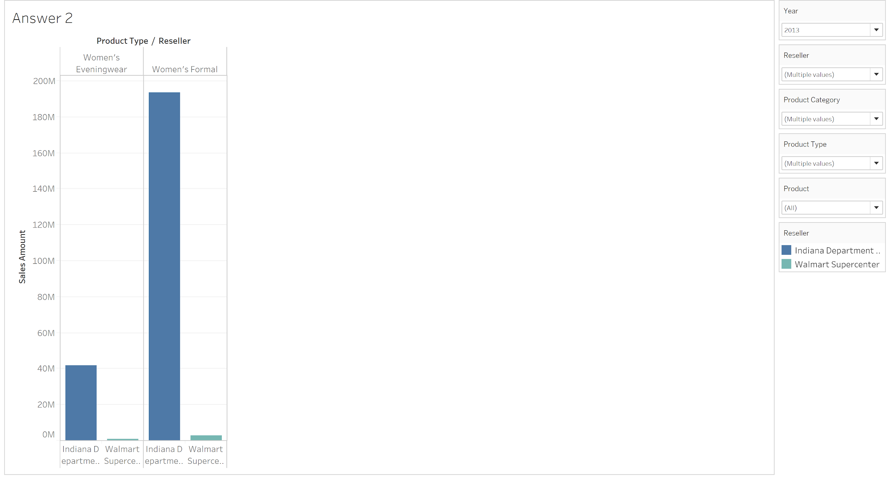
2: Recommend separate 2013 and 2014 bonus amounts for each reseller if the total bonus pool for 2013 is $100,000 and the total bonus pool for 2014 is $200,000. Base your recommendation on how well the resellers are selling Product Types of Women’s Eveningwear and Woman’s Formal.

Slide 17
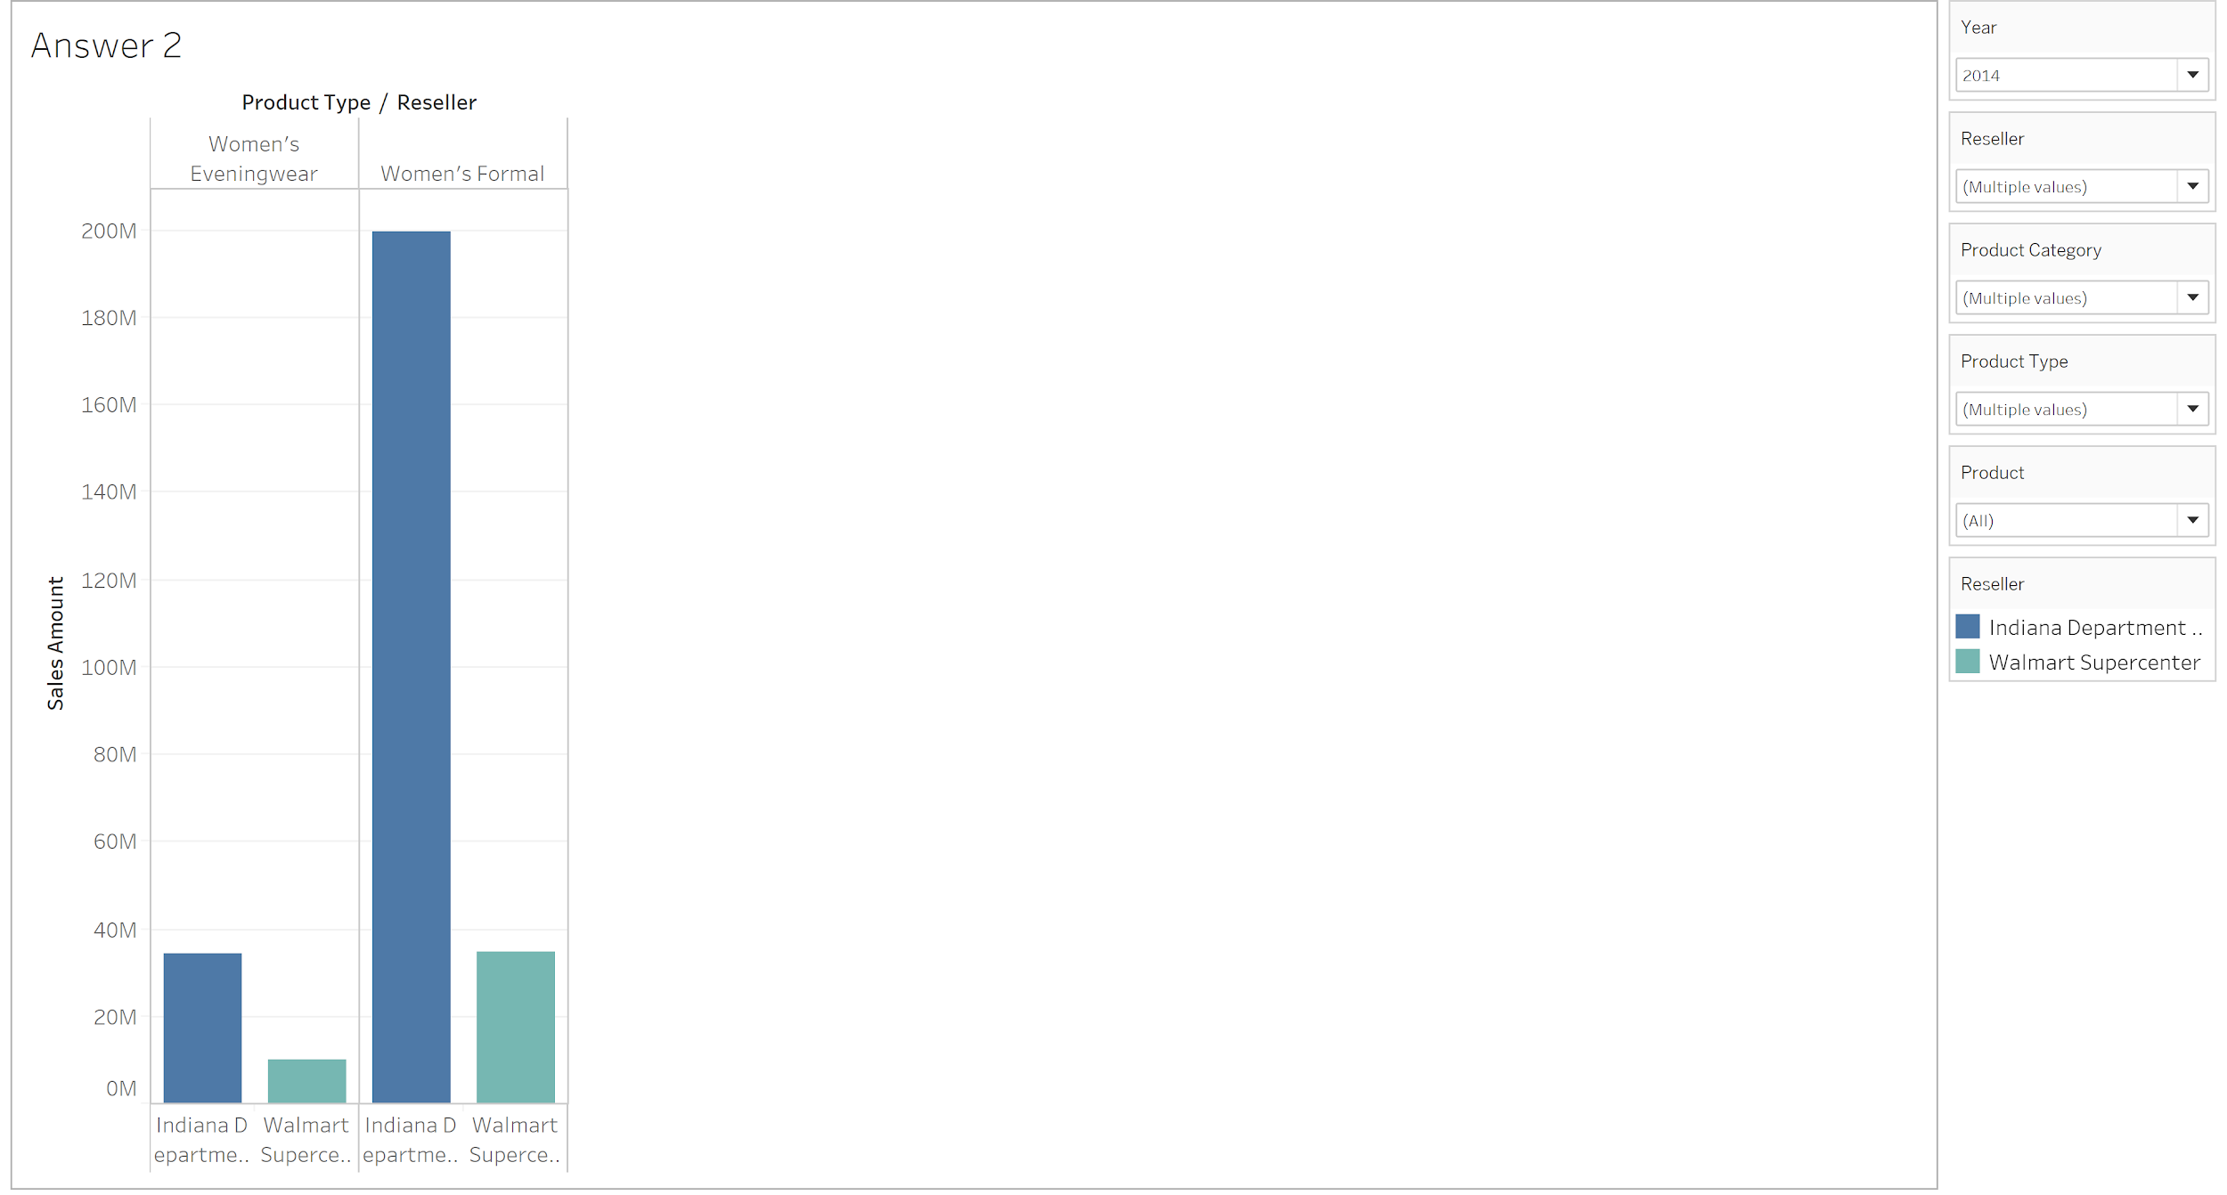
2: Recommend separate 2013 and 2014 bonus amounts for each reseller if the total bonus pool for 2013 is $100,000 and the total bonus pool for 2014 is $200,000. Base your recommendation on how well the resellers are selling Product Types of Women’s Eveningwear and Woman’s Formal.
Notes:
0.8391 = $ 671,280
Rest = $ 128,720 .9863 = 986300

Slide 18
2: Recommend separate 2013 and 2014 bonus amounts for each reseller if the total bonus pool for 2013 is $100,000 and the total bonus pool for 2014 is $200,000. Base your recommendation on how well the resellers are selling Product Types of Women’s Eveningwear and Woman’s Formal.
As we do not have the target data for the Product Types of Women’s Eveningwear and Woman’s Formal, we recommend dividing the bonuses for the year of 2013 and 2014 on the basis of the ratio of their Sales Amount for these Product Types
Therefore, we recommend the following figures: 2013 ($100,000) Indiana Department Store - $98,635.48 (98.64%) Walmart Supercenter - $1,364.52 (1.36%) 2014 ($200,000) (as per available data) Indiana Department Store - $167,827.08 (83.91%) Walmart Supercenter - $32,172.92 (16.09%)

Slide 19
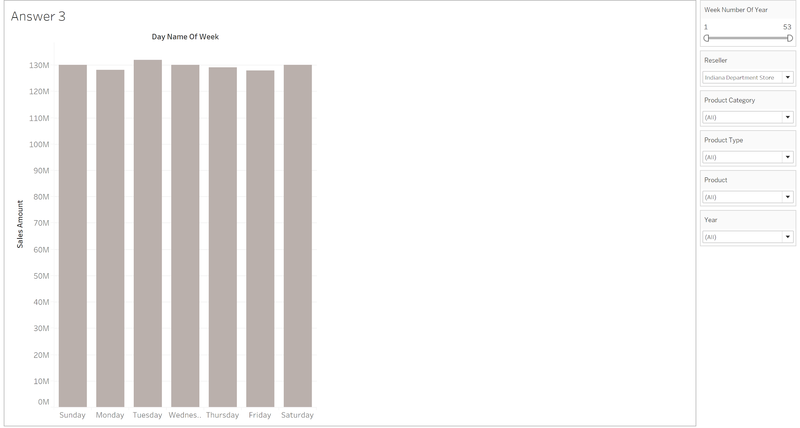
3: Assess product sales by day of the week at the resellers. What can we learn about sales trends?

Slide 20
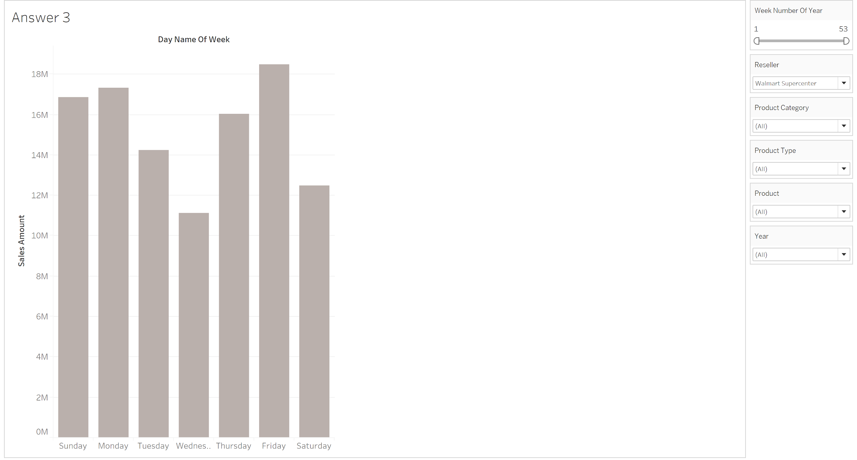
3: Assess product sales by day of the week at the resellers. What can we learn about sales trends?

Slide 21
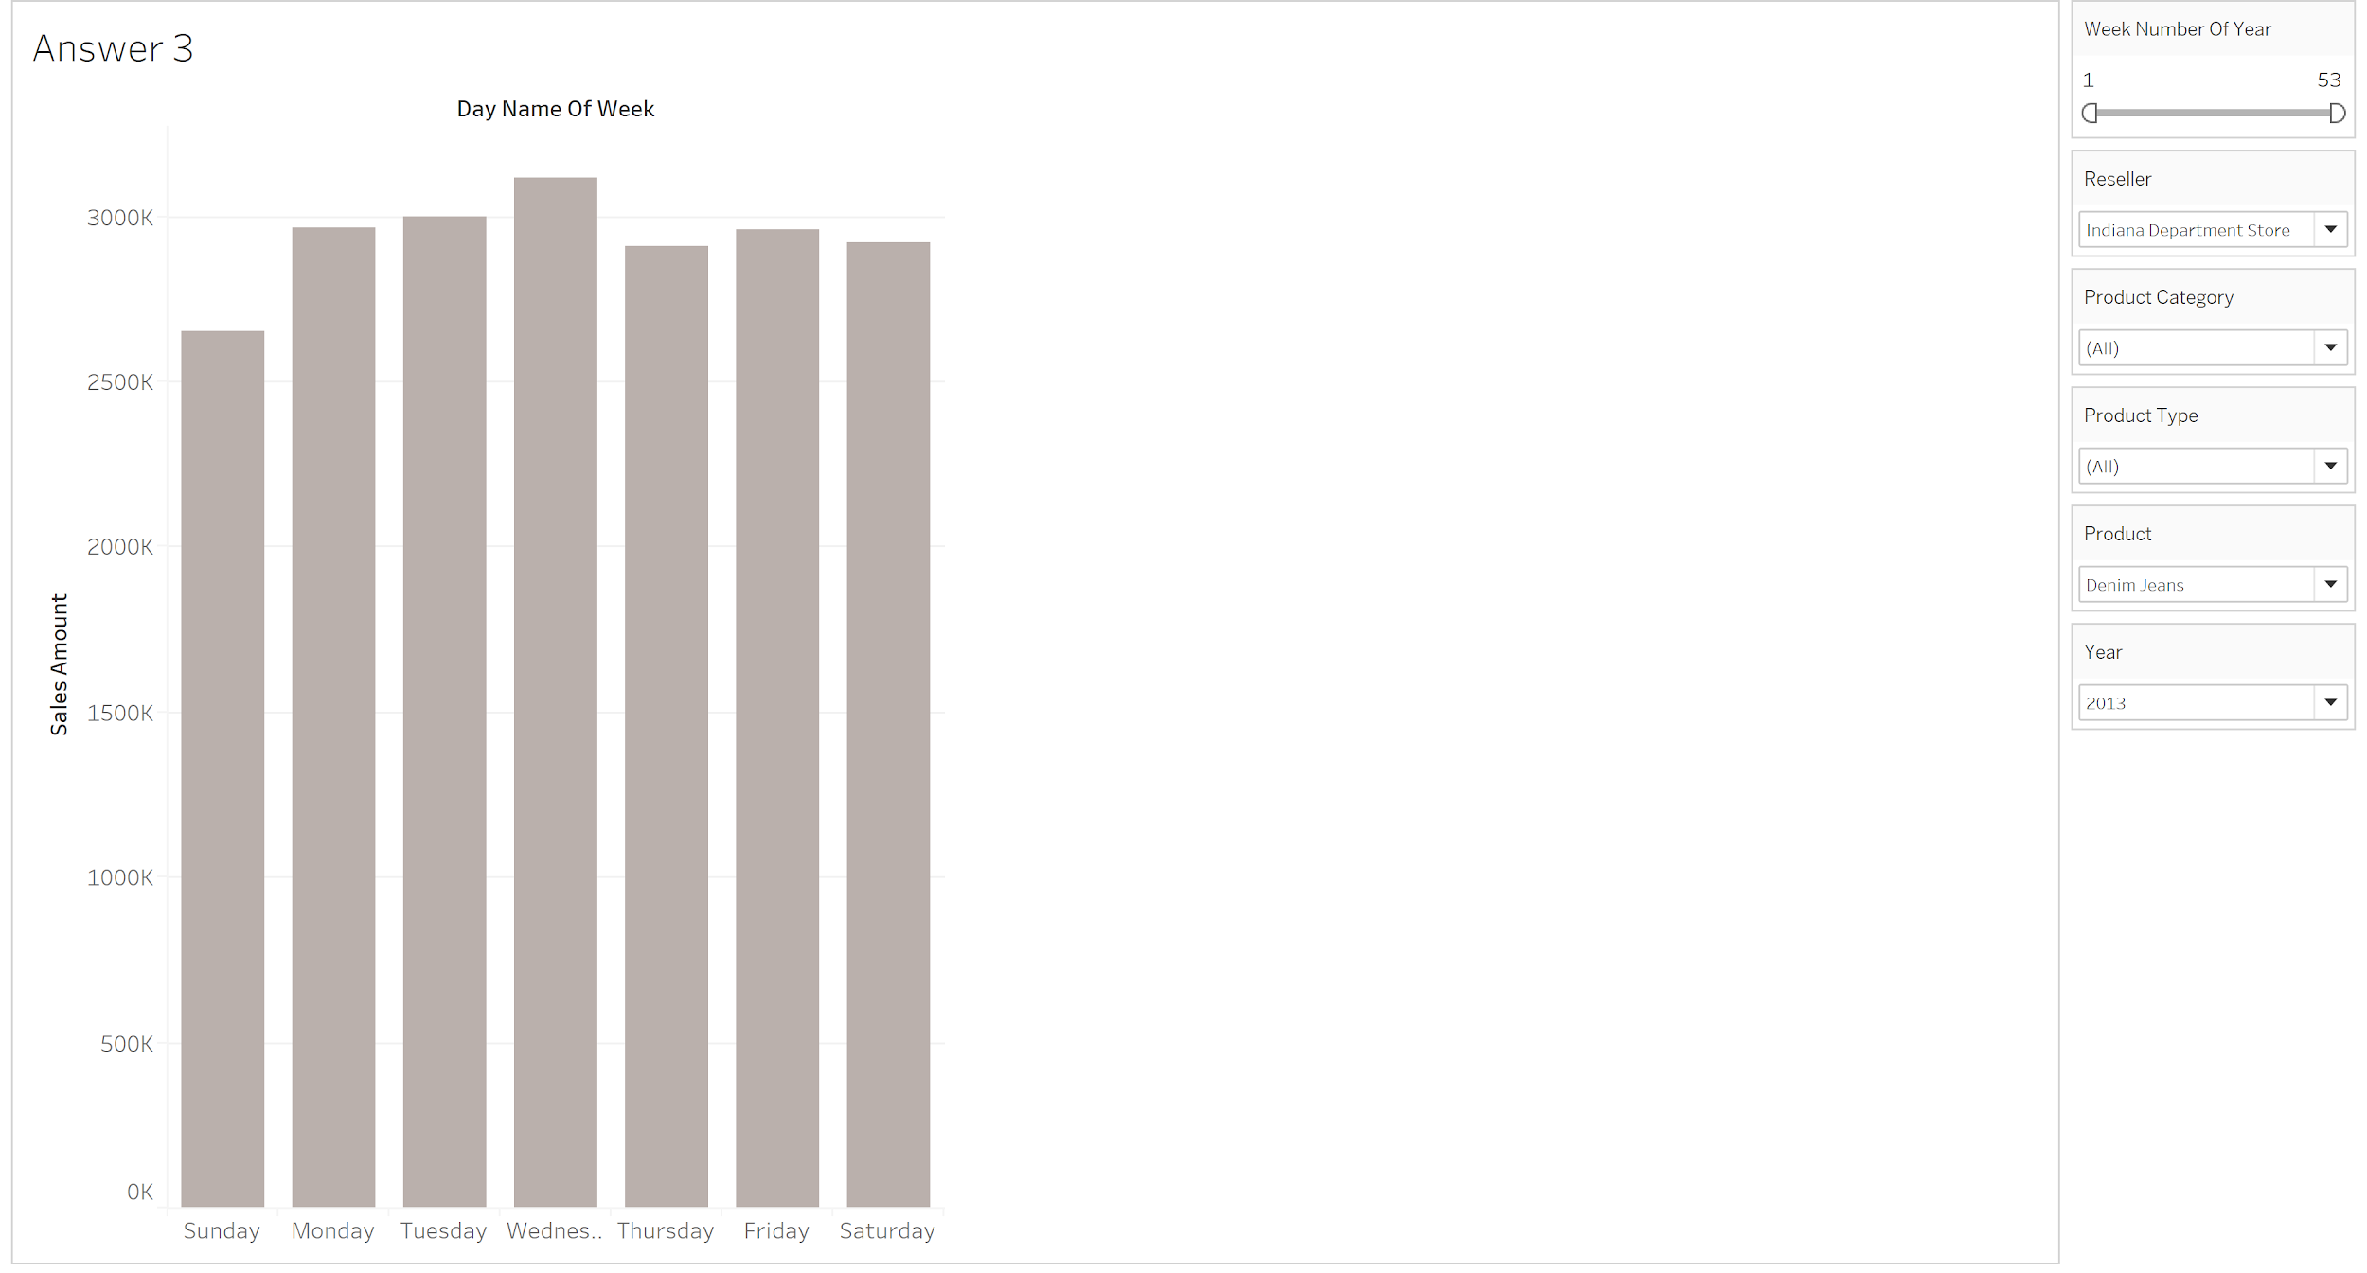
3: Assess product sales by day of the week at the resellers. What can we learn about sales trends?

Slide 22
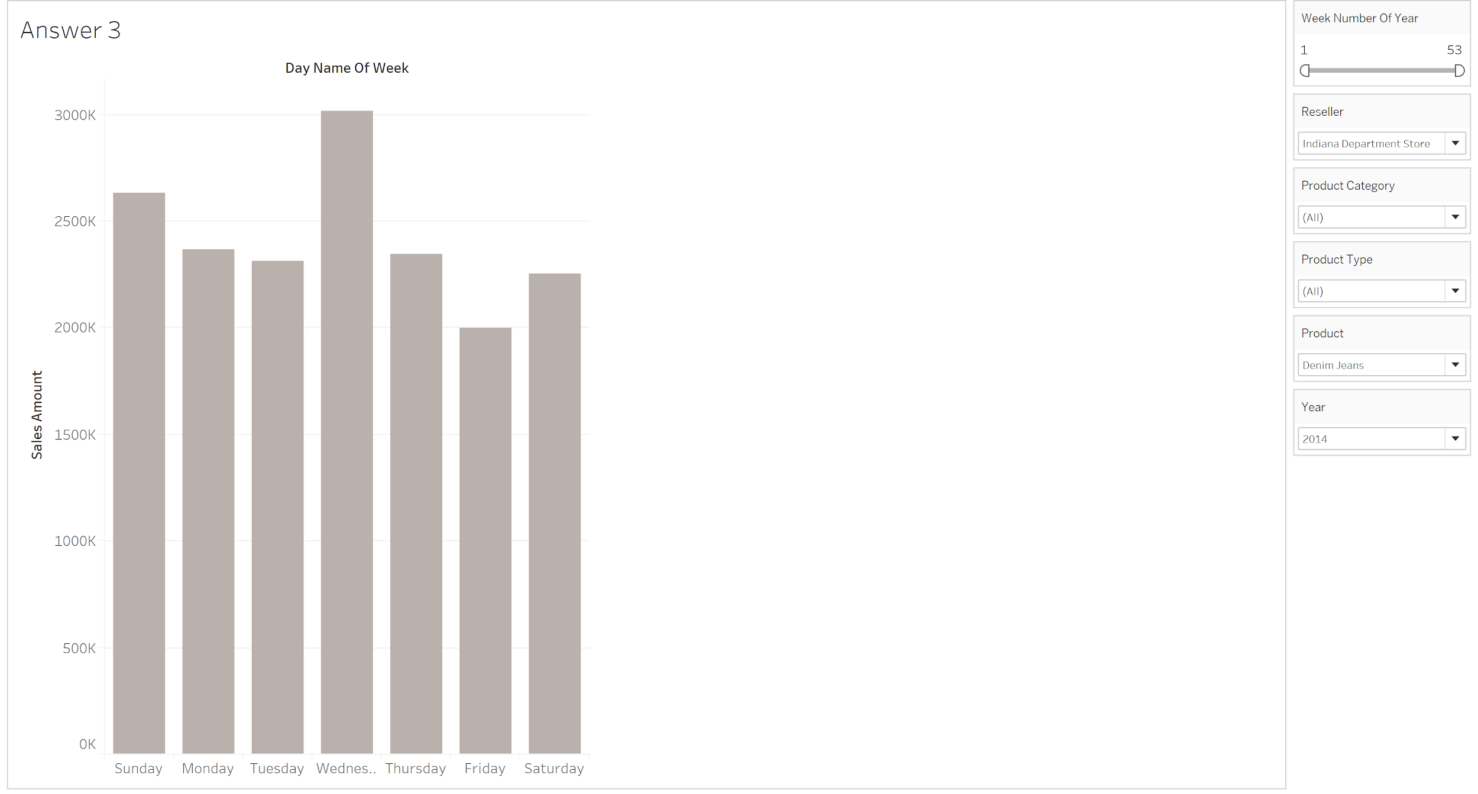
3: Assess product sales by day of the week at the resellers. What can we learn about sales trends?

Slide 23
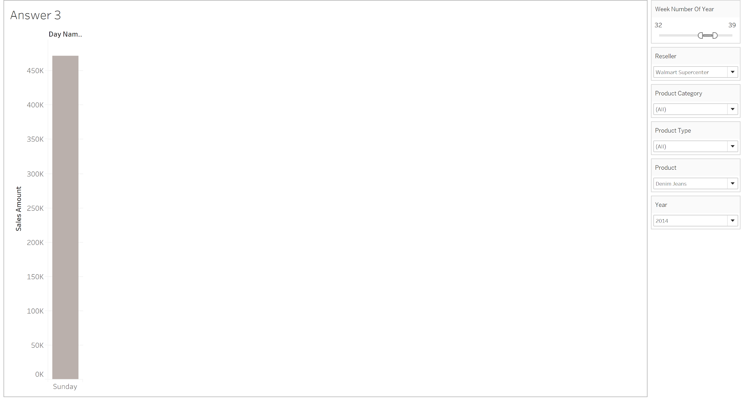
3: Assess product sales by day of the week at the resellers. What can we learn about sales trends?

Slide 24
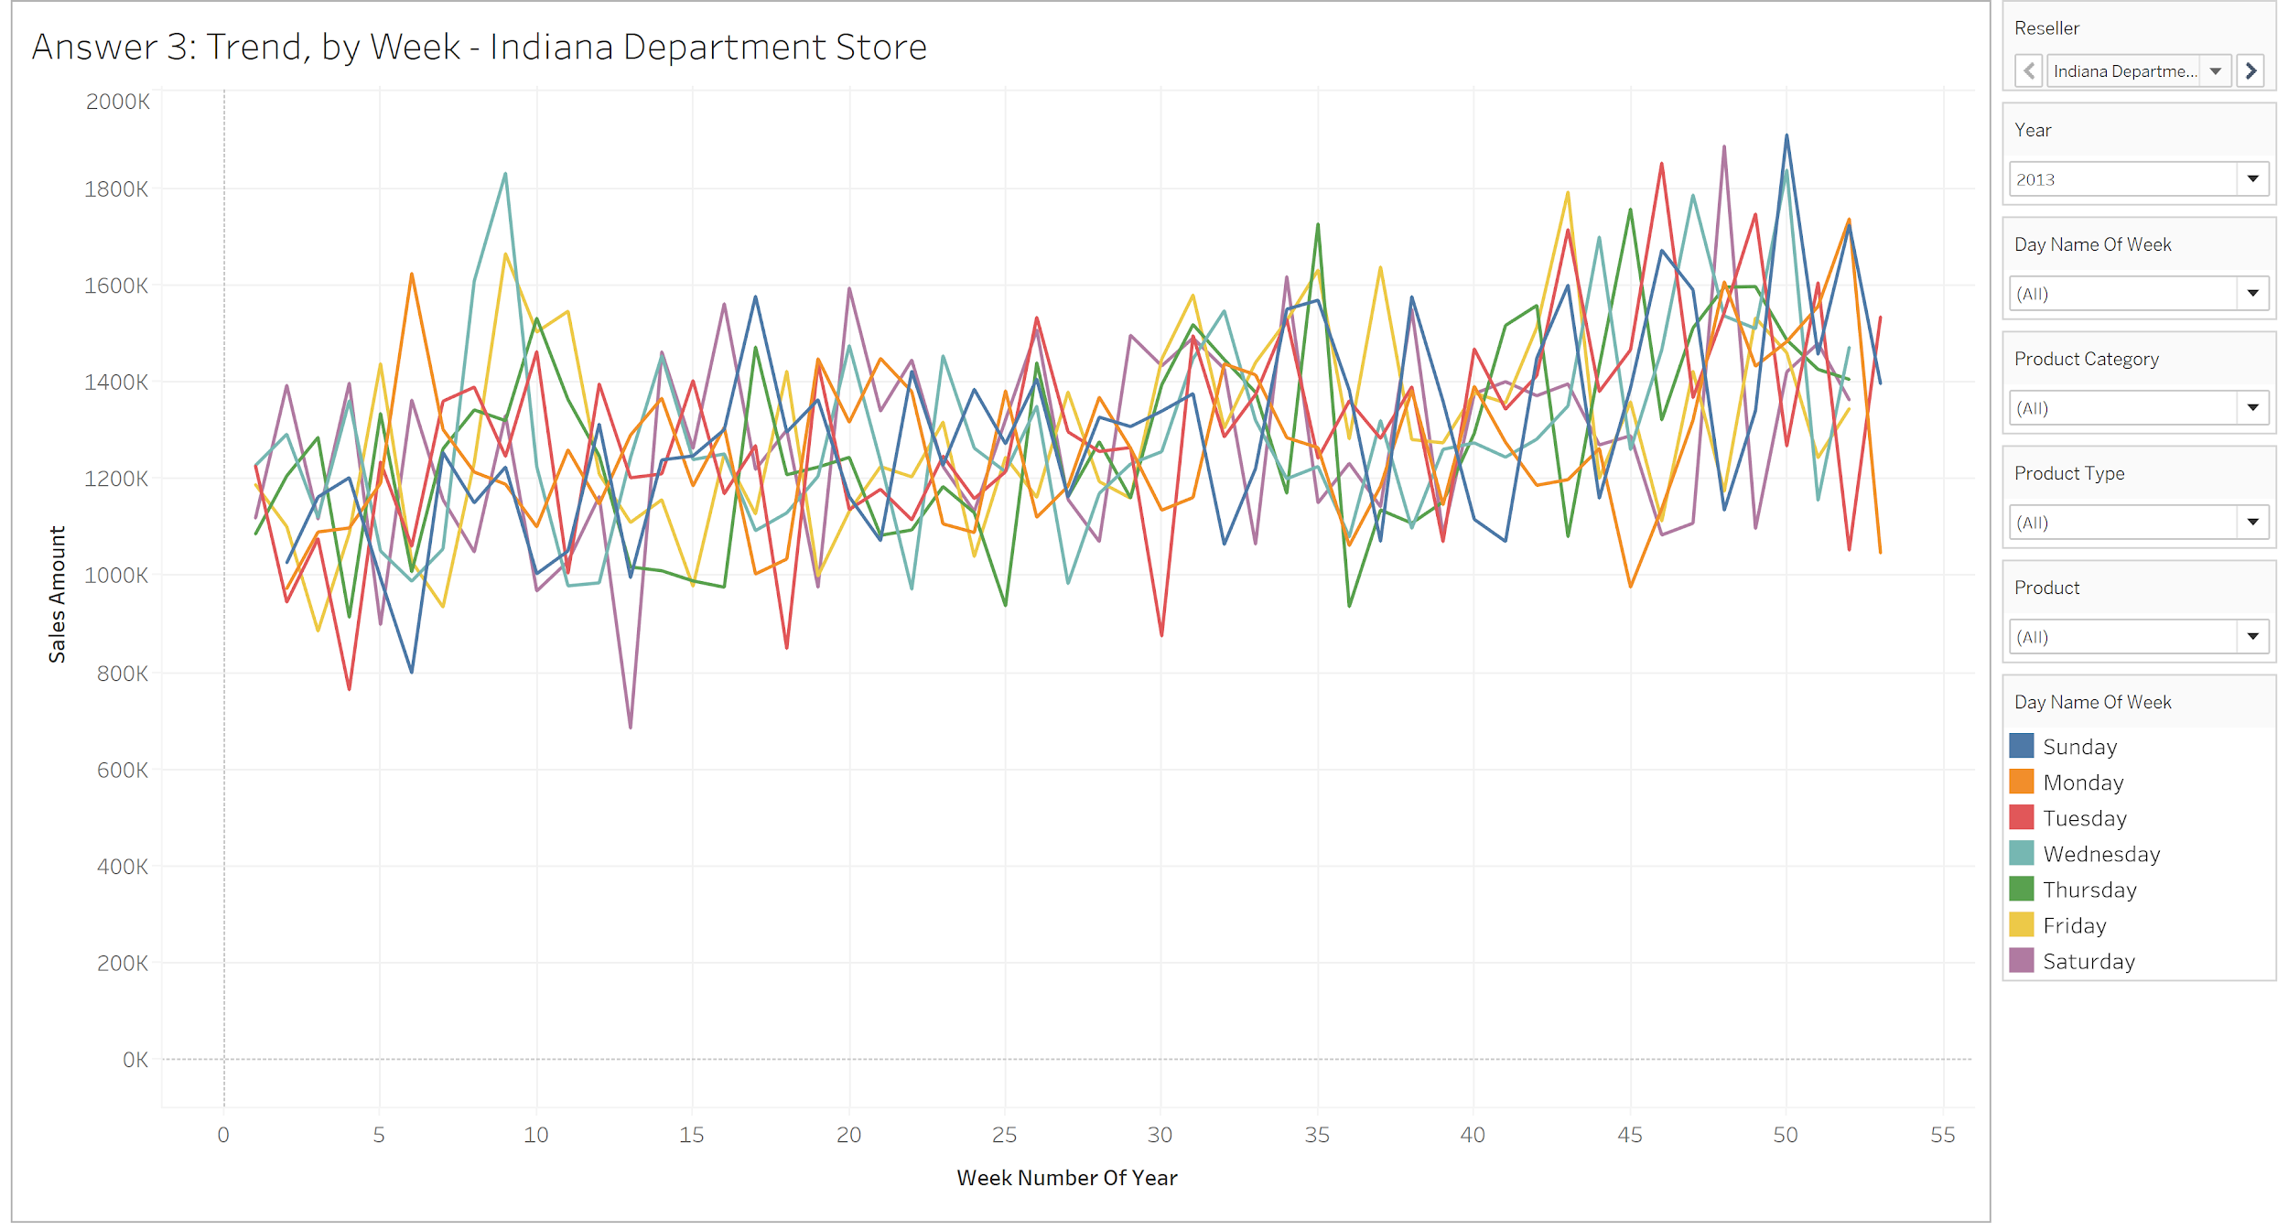
3: Assess product sales by day of the week at the resellers. What can we learn about sales trends?

Slide 25
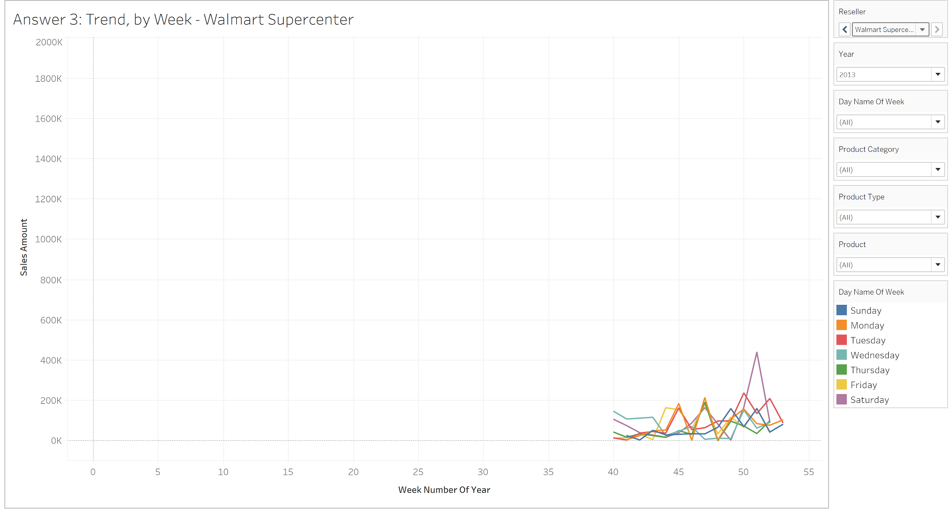
3: Assess product sales by day of the week at the resellers. What can we learn about sales trends?

Slide 26
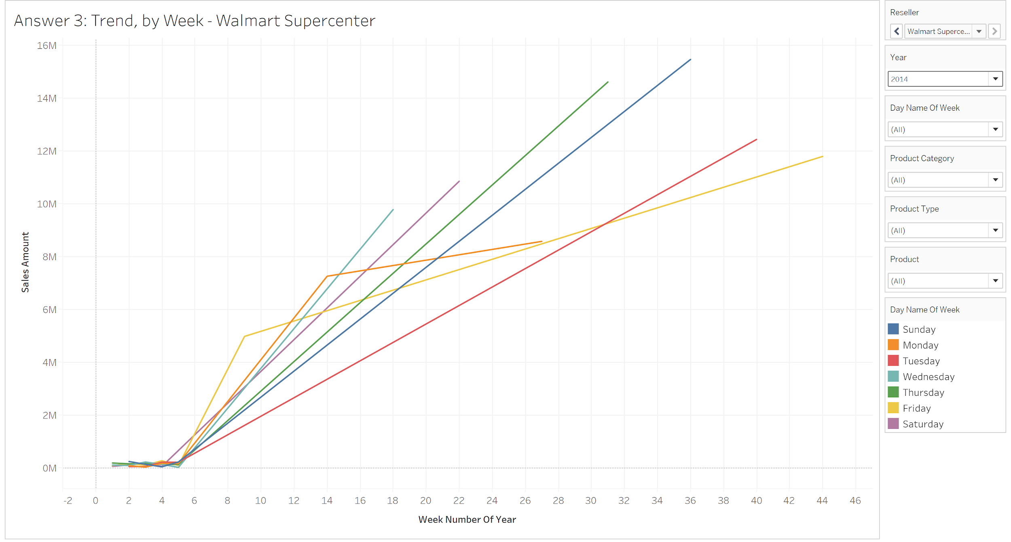
3: Assess product sales by day of the week at the resellers. What can we learn about sales trends?

Slide 27
3: Assess product sales by day of the week at the resellers. What can we learn about sales trends?
We do not observe anything significant if we have all the data displayed by day of the week for Indiana Department Store, but we see a pattern if we observe the data of Walmart Supercenter with peaks on Friday and Monday
We performed an example analysis of Denim Jeans for Indiana Department Store to see if we could observe any trend by specific product; we observed that for the year 2013, the Sales Amount a peak on Wednesdays which is not significant, but the same peaks becomes highly significant for the year 2014
Also, we observe that Denim Jeans shows different results for Walmart Supercenter for the 2014, where it only has Sales Amount on Sunday for the weeks of 32-39. This behavior can be observed for different days for different selection of weeks
Overall, we observe a rising trend for all the products in the year 2013 for Indiana Department Store, while we only have data post the 40th week for Walmart Supercenter which limits our analysis for 2013
Although, we observe highly unusual trends for Walmart Supercenter for the year 2014 with days such as Sunday or Monday, posting sales on only few weeks of the year

Slide 28
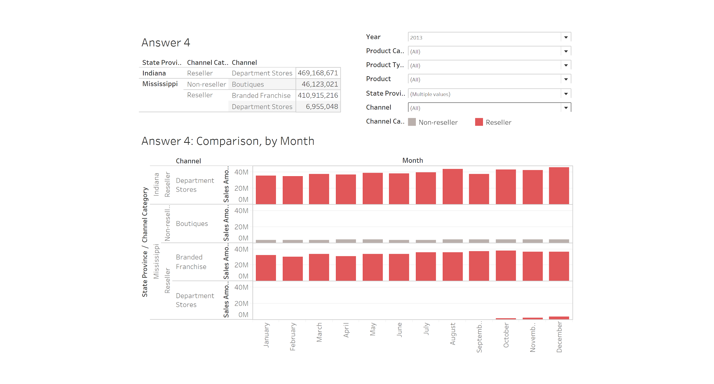
4: Compare the performance of resellers located in states with other non-reseller sales in the same state vs resellers that are in states without non-reseller sales in the same state. What can we learn about co-locating resellers with other types of sales?
Notes:
But in the case of indiana it is increasing. There is big decrease for branded franchise but an increase in departmet stores. And increase in the sales of the non-reseller
Increase in the Departmet stores for Indiana. Therefore,

Slide 29
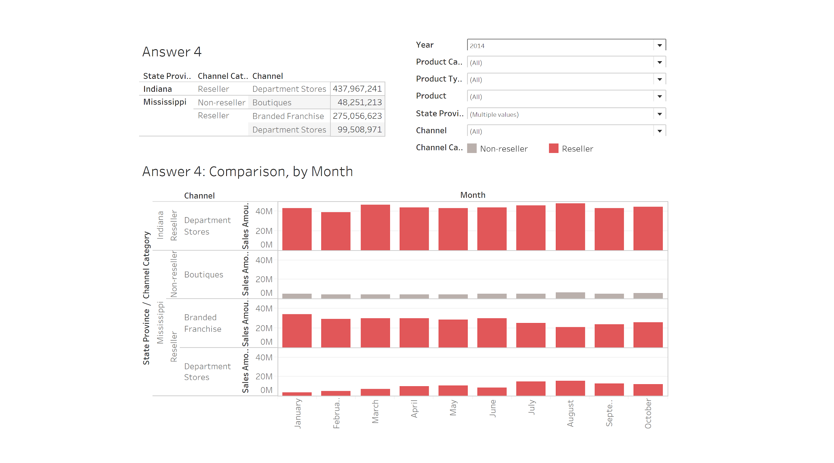
4: Compare the performance of resellers located in states with other non-reseller sales in the same state vs resellers that are in states without non-reseller sales in the same state. What can we learn about co-locating resellers with other types of sales?
Notes:
Indiana and Misippie
In Indiana we only have resellers
In missipiee we have resellers as well as non-resellers

Slide 30
4: Compare the performance of resellers located in states with other non-reseller sales in the same state vs resellers that are in states without non-reseller sales in the same state. What can we learn about co-locating resellers with other types of sales?
We do not observe any significant trend change if we compare the resellers and non-resellers performance for the states of Indiana and Mississippi in the year 2013; also we only have data for the Department Store of Walmart Supercenter for the last quarter
We can observe a decline in the sales of Branded Franchise in the state of Mississippi and an increase in the sales of Department Store for the year 2014, but the sales of Boutiques doesn’t have a significant impact.
We do not observe any significant impact of non-resellers with resellers as per the observations made, while it is possible that the decline in sales of the Branded Franchise could have been brought about by the rise in the sales of Department Stores in Mississippi

Slide 31
Thank you

